Slide 1


Savey
…for the savvy shopper
February 21, 2015

Slide 2

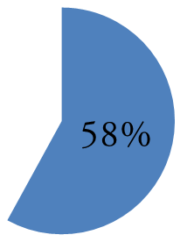
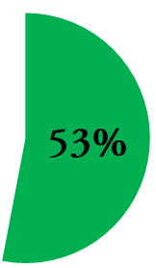

The Problem
Out of 88 people surveyed:
persons spend more than expected
persons care more about price than quality
Notes:
According to USDA 2 people should be spending 390 on grocery but average spend 750

Slide 3
Initial Solution
Provide consumers a way to access in store prices that they otherwise could not find online
How?
An application that takes a shopping list and returns:
Store that has each item at the cheapest price
Store that you can get list at lowest total cost

Slide 4
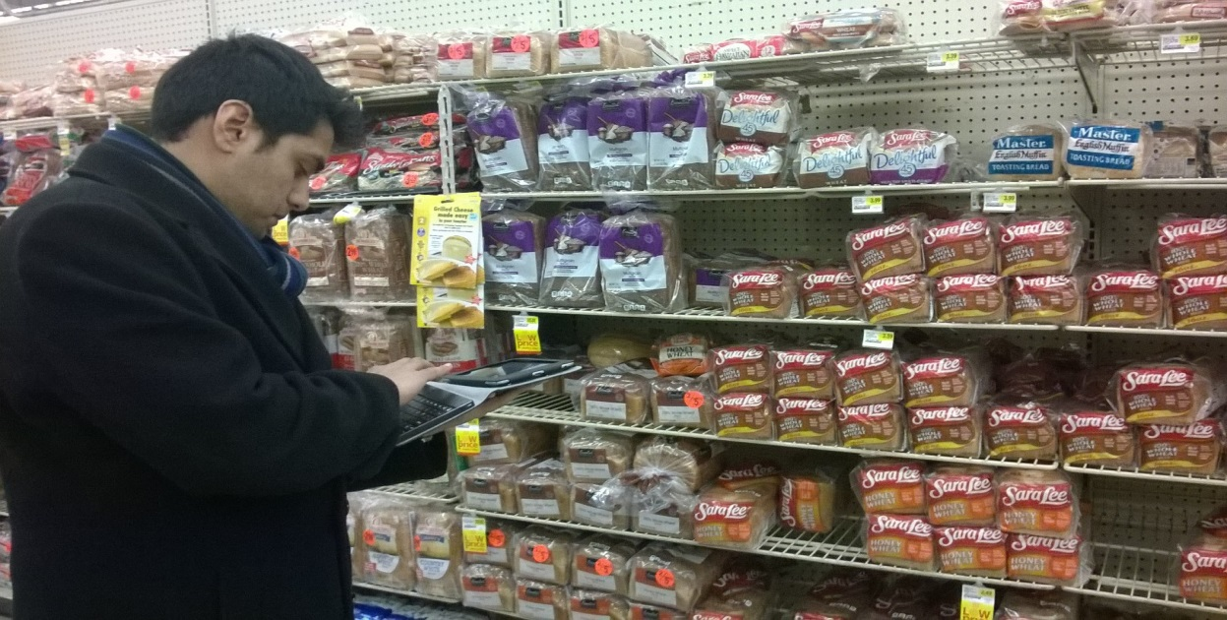
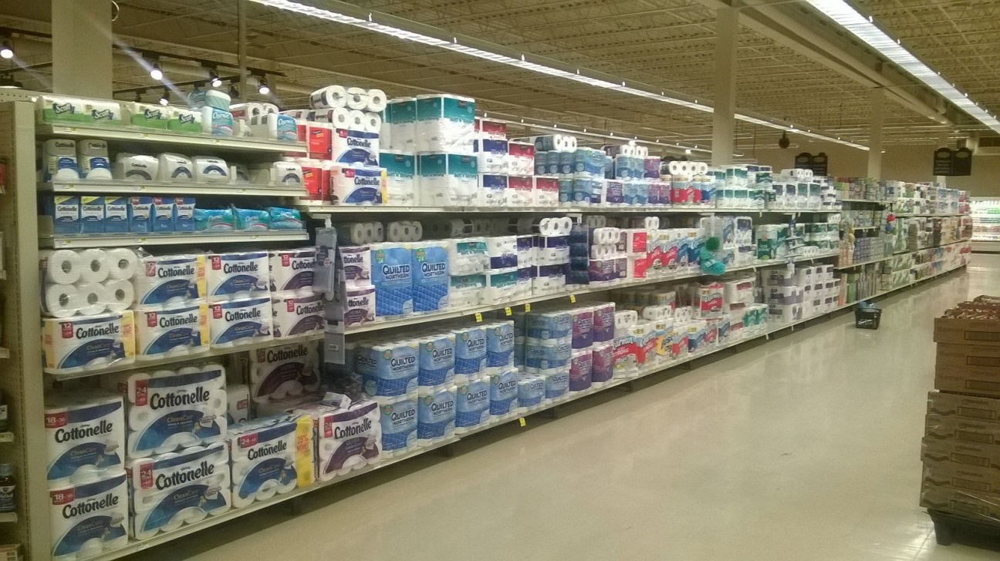

Slide 5
We found that:
High complexity in product base
Negligible savings on basic items

Slide 6
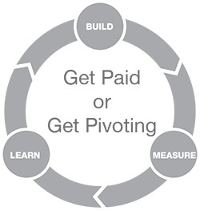
Pivoting
We needed to find goods that:
1. Real savings
2. Prices unavailable online
3.People are sensitive to price
Decided to focus on the fish and meat market

Slide 7

How does Savey work?

Slide 8
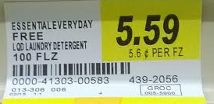


Crowdsourcing
Ease of use:
Simply upload picture of price tag
(geotagging and push-notifications)
Incentives:
Point-reward system and competition
Donation per upload to food charities
Builds sense of community
Successful examples:

Slide 9
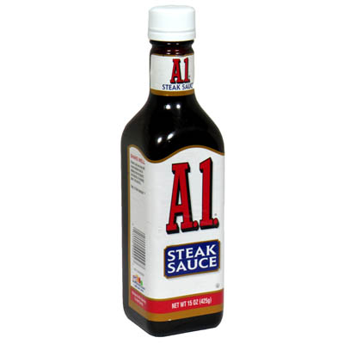

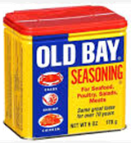
Revenue Model
Initially will be advertisements for products related to meat and fish
Opportunities for revenue will expand as we grow…

Slide 10

Growth
Step 1. Exploit 2-sided network effect
Step 2. Then focus crowdsourcing on other items
Step 3. Take advantage of data
Notes:
Step 1-156 Billion in food wasted, 9% fish wasted and 12% in fruits and veggies and 4.3% in meat, reduce meat wastage by pushing sales
Step 2- expand product selection
additional revenue stream from product placement
Step 3
High demand for similar data (e.g. instant.ly)

Slide 11
Marketing
Pre-populated database at launch
Build a socially responsible brand
Strategic partnerships with charities
Donation-based referral system
Social media, SEO, adwords campaign
Notes:
Launch-Purchase data
Build Social- - Reduce food wastage
- Let people vote on charities for donations

Slide 12



Competition
Online price aggregators and coupon/sale apps
How do we deal with new entrants?
Notes:
1- Lack in-store price data
Why no copy-
First mover advantage where investment is key
Gives us a strong customer base
Brand image
Network of grocery stores

Slide 13
Investment
Initially would look for convertible debt financing
A potential exit would be a merger/acquisition opportunity

Slide 14
Any Questions?

